Slide 1
Data Jobs
Job search for Data professionals
Amil Walgamage, Babette Blanquet, Jamie Tan, Tas Tudor

Slide 2
Project Summary
Project Problem Statement
There is not a specific jobs portal for data professionals.
Desired Outcome
To build a live portal to provide current information and job listings to prospective data professional job seekers.
Outcome
We were able to build a portal successfully with interactive visualisations and display the latest available jobs for Data Professionals.

Slide 3
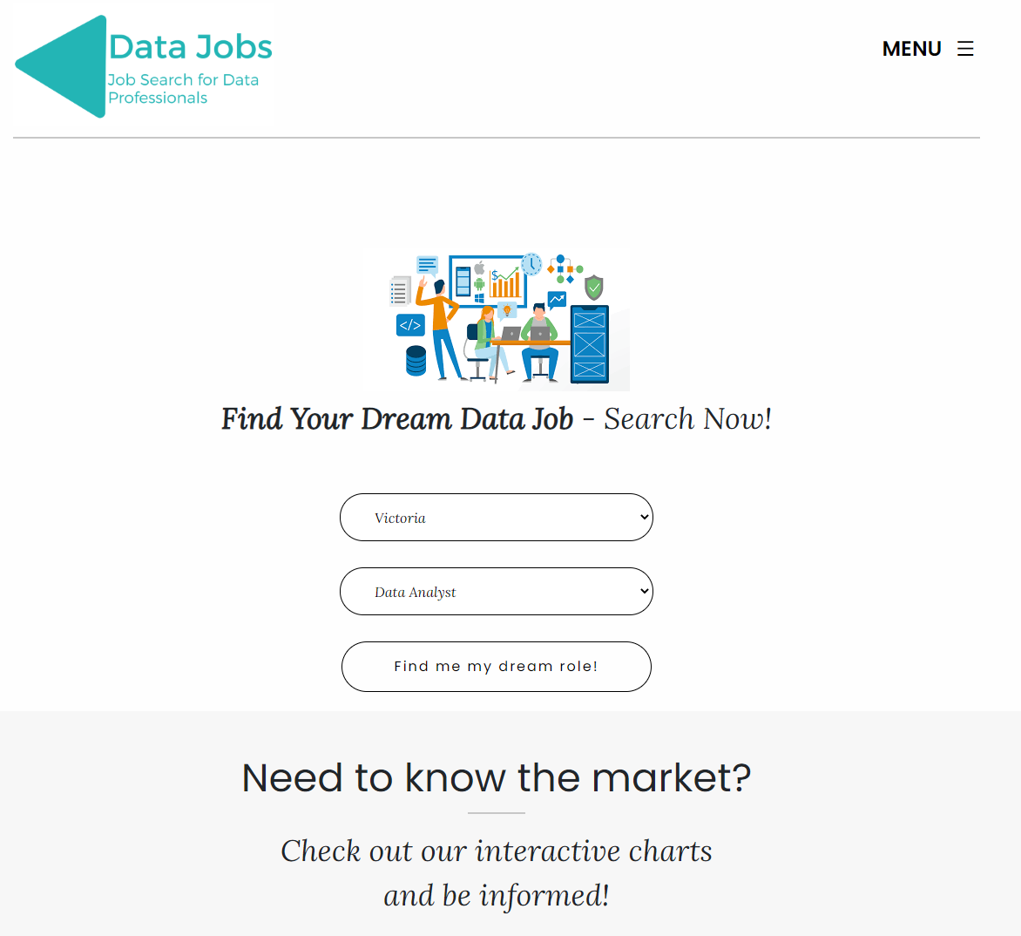
Visualising Australian Data Jobs
The site provides insights into the Australian data job market in a few clicks.
The user selects the filters:
State
Job Role
Following the selection:
4 visualisations appear providing insights.
The latest jobs with a salary benchmark tool.

Slide 4
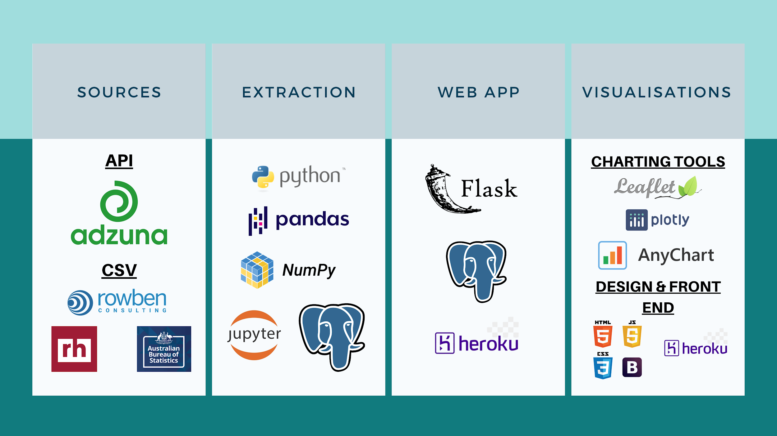
The Toolbox

Slide 5
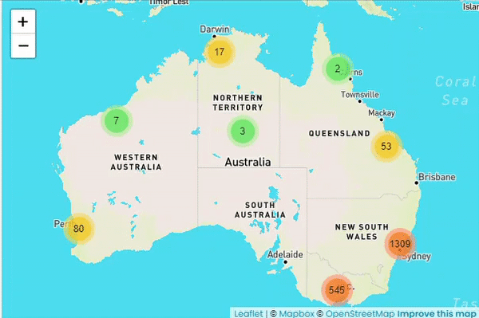

Map: Number of jobs per state

Slide 6
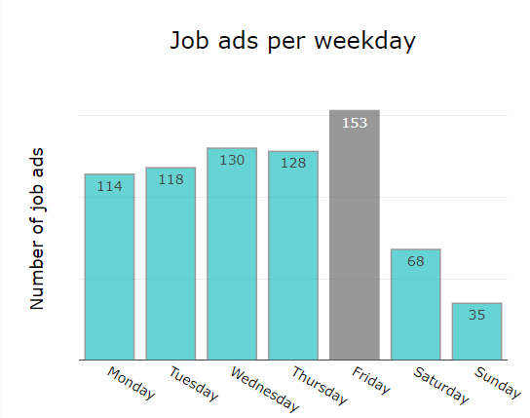
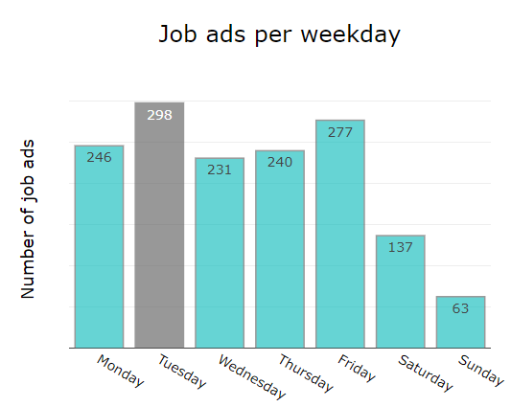

Best day to search for a job
All Jobs in Victoria
All Jobs in NSW

Slide 7
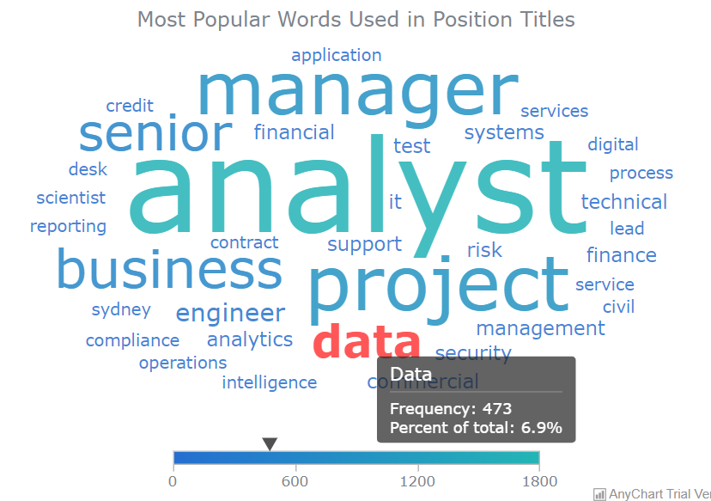

Data Visualisation: Word Cloud

Slide 8
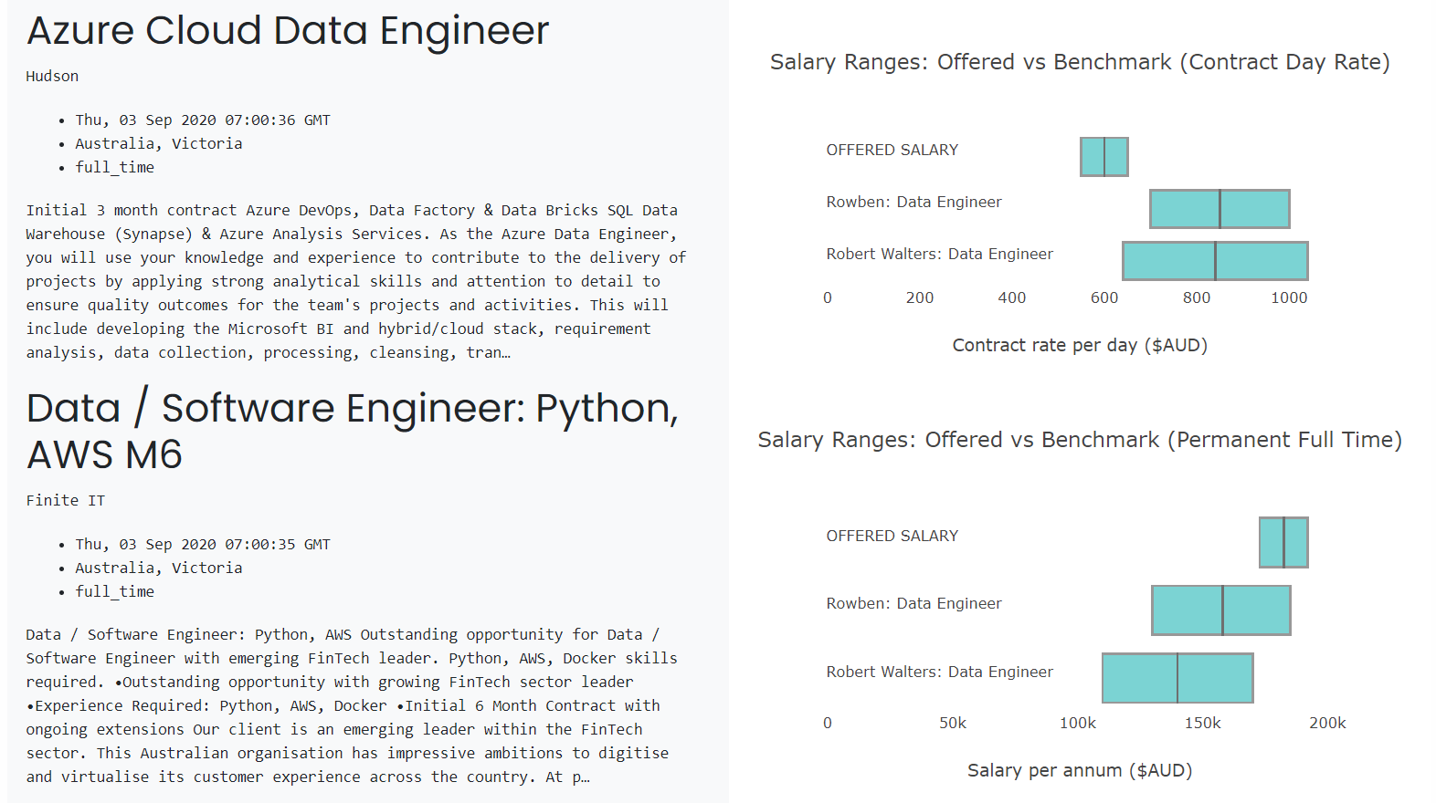
Data Visualisation:
Job Details & Salary benchmark

Slide 9
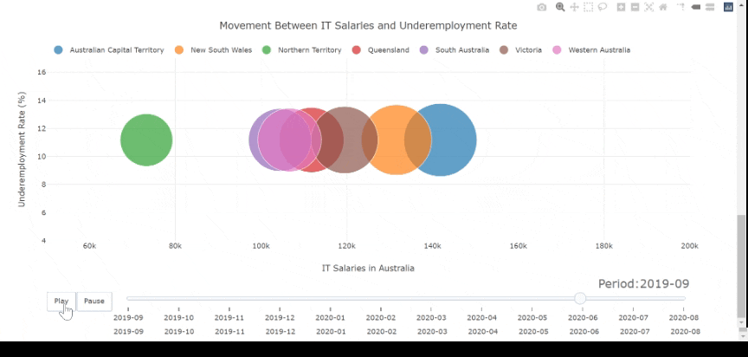
Data Visualisation: Movement in Time
Correlation between IT Salaries & Underemployment Rate

Slide 10
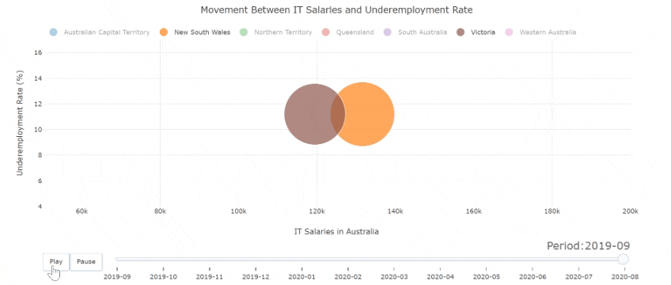
Data Visualisation: Movement in Time
Correlation between IT Salaries & Underemployment Rate

Slide 11

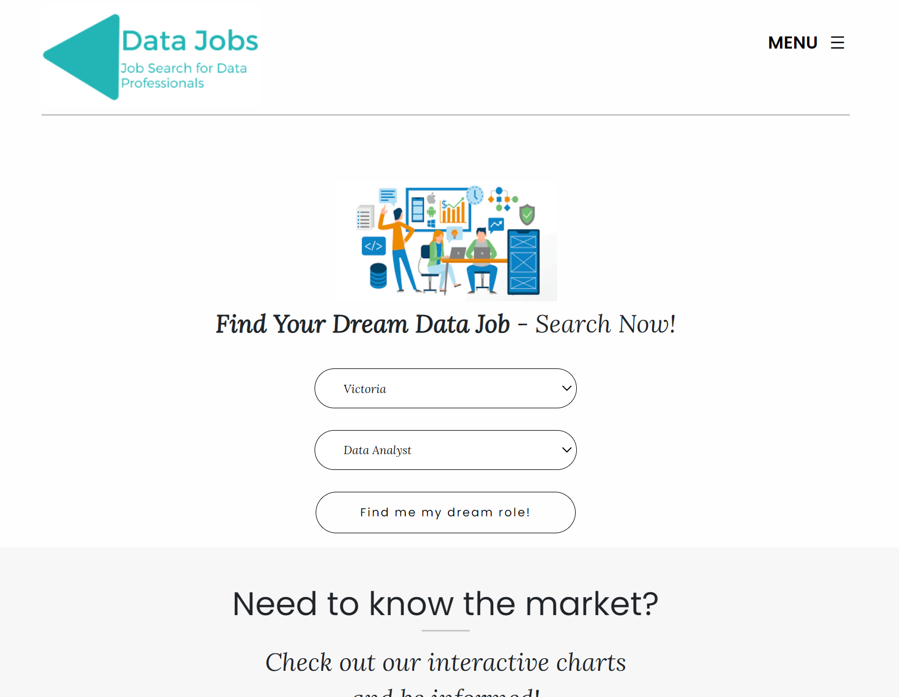
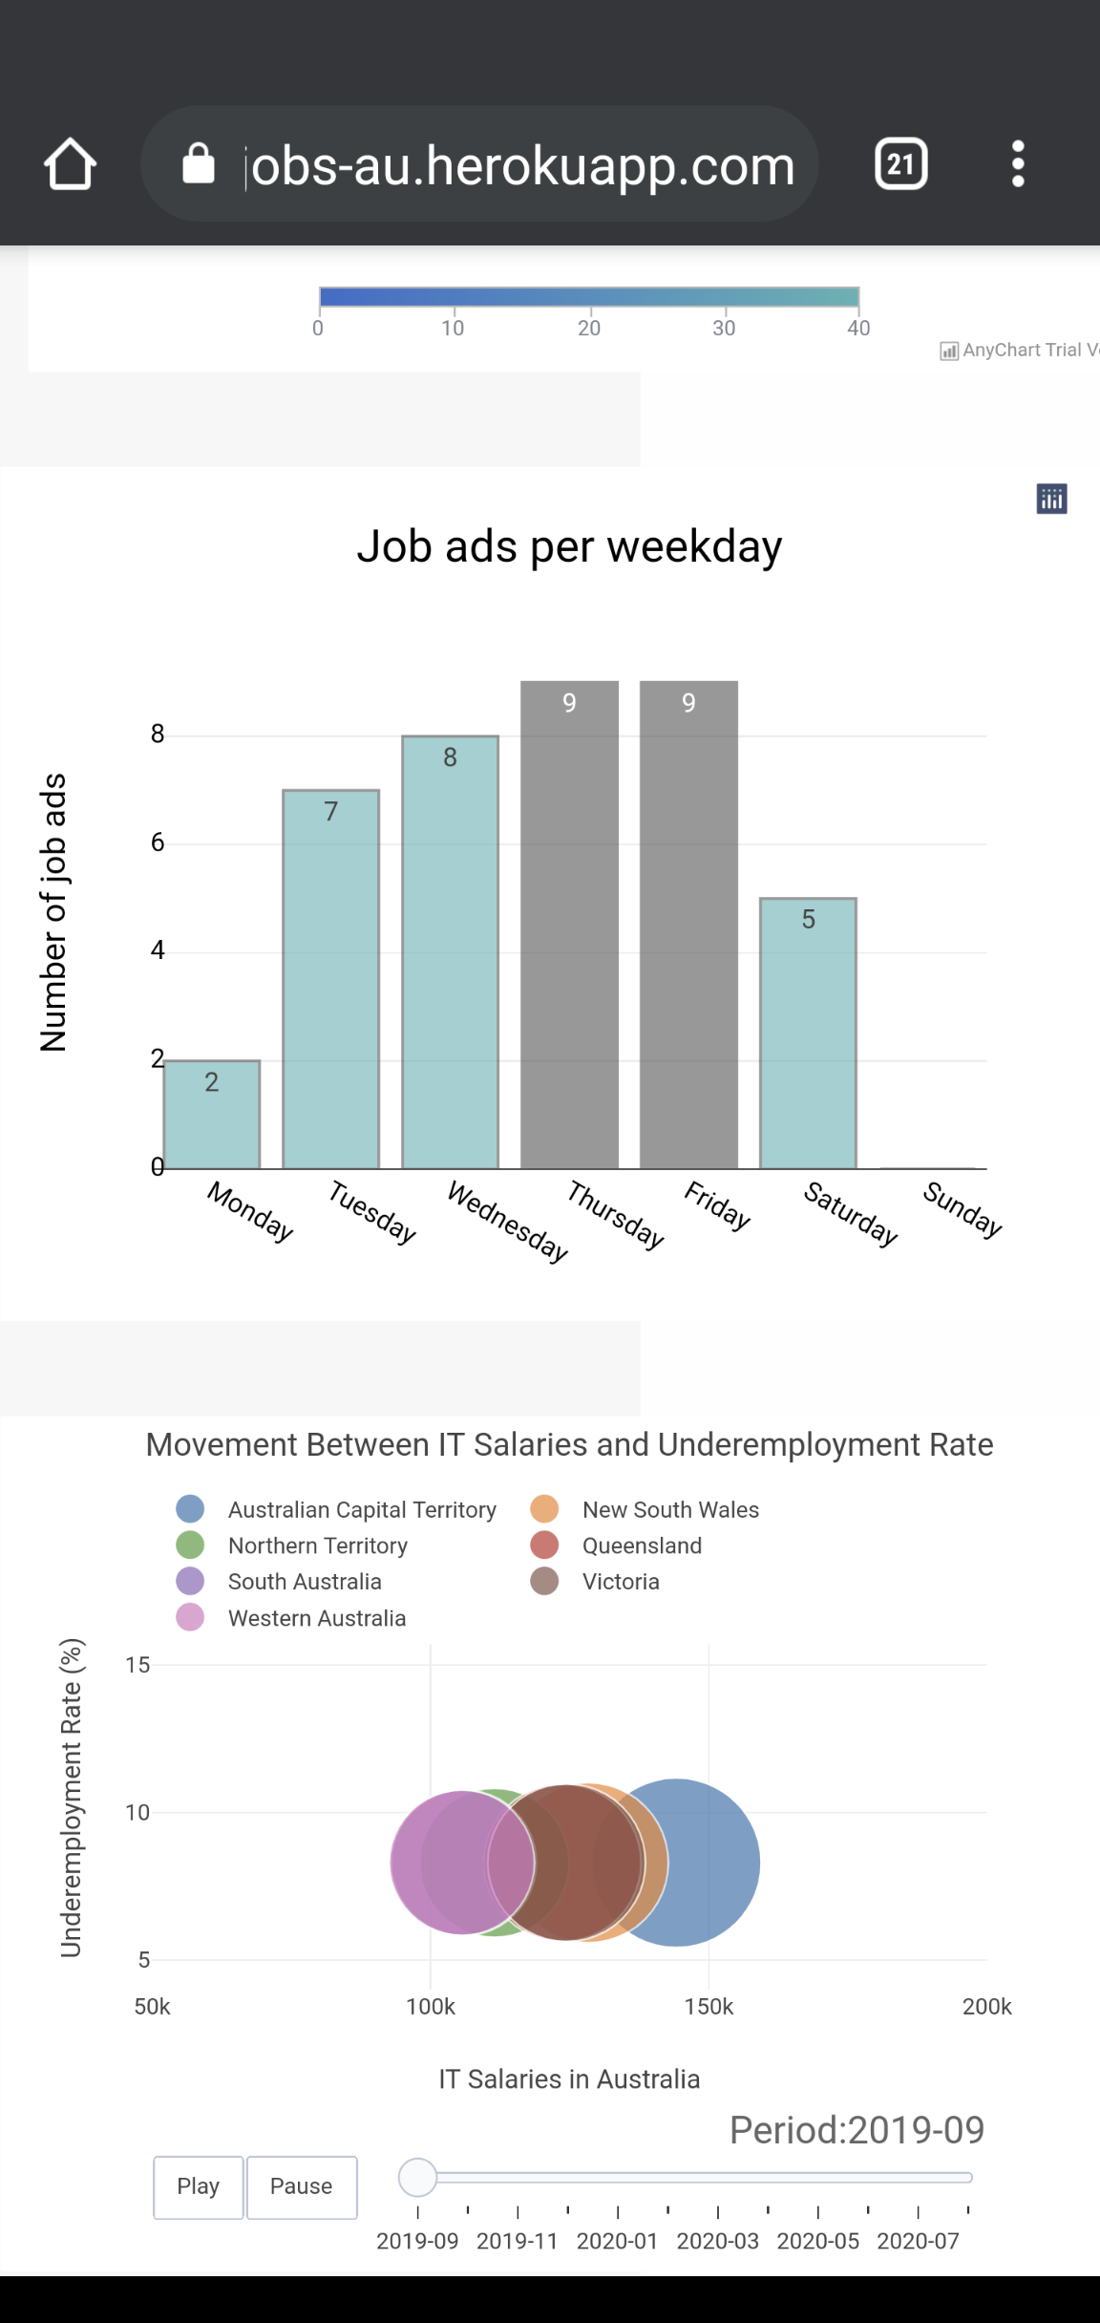
Front end app deployed on

Slide 12
Conclusion
Challenges
Pivot was required from getting live jobs from LinkedIn and Seek
Dependency / version clashes
Classification of the job roles
If we had more time……
Further cleaning of the code in respect of “titles”, “salaries” etc
Explore obtaining more information from Seek or LinkedIn
Tidy up the site layout and CSS
Provide some more pages and insights
User input fields and search
Other specialisations …….

Slide 13
DEMO

Slide 14
QUESTIONS
&
THANKS

